Slide 1
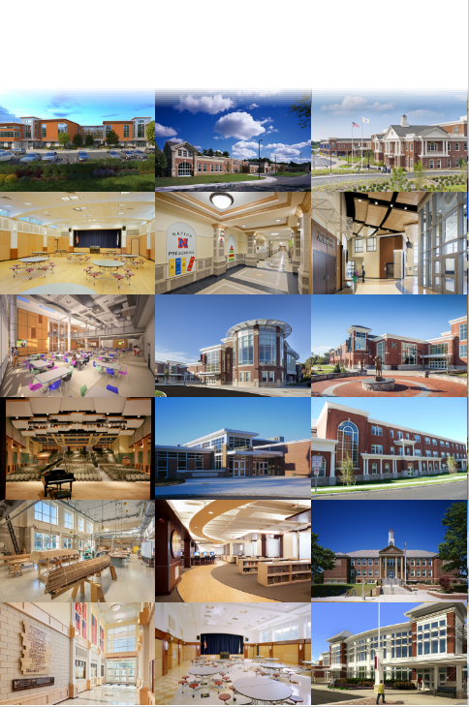
Watertown Public Schools Building Committee
Design Watertown
Agenda – August 16, 2023
Call to Order
Review and Approval of Meeting Minutes
  Elementary School Projects – July 19, 2023
Review and Approval of:
  Elementary Schools Monthly Invoices
  Lowell Elementary School Project -Change Order No. 9
Executive Summary
Elementary School - Questions / Comments
Elementary Schools Project
Hill International, Inc.
Ai3 Architects, LLC
To Connect via Zoom*: Passcode: 899084
https://us02web.zoom.us/j/85782901747?pwd=UnF1UVhGVDZHTStjYmZiRnkwOGF6UT09
*Members of the Public: Please use the Q&A button to ask questions when appropriate or email questions to: buildingforfuture@watertown-ma.gov

Slide 2
Watertown Public Schools Building Committee
Call to Order

Slide 3
Watertown Public Schools Building Committee
Approvals
Meeting Minutes
  Elementary School meeting minutes for
  July 19, 2023
Invoices
  Elementary Schools Project Invoices (July 2023)
  Lowell Elementary School Project -
  Change Order No. 9

Slide 4
Approvals
Summary of Invoices
Elementary Schools Project
For work completed during July 2023
Vendor | Project | Invoice Date | Invoice Number | Invoice Amount
Hill International | Elementary Schools | 08/11/23 | 51 | $67,560.00
Ai3 Architects | Elementary Schools | 07/31/23 | 0065B-1610.00 | $8,141.19
Ai3 Architects | Elementary Schools | 07/31/23 | 0053E-1610.00 | $5,914.35
Ai3 Architects | Elementary Schools | 07/31/23 | 0044R-1610.00 | $675.00
Brait Builders | Elementary Schools | 07/31/23 | Application #38 | $443,156.03
CTA Construction Managers | Elementary Schools | 07/31/23 | Application #17 | $2,289,204.87
Ridgeline Energy Analytics (Hosmer) | Elementary Schools | 08/04/23 | 1615 | $187.50
Ridgeline Energy Analytics (Lowell) | Elementary Schools | 08/04/23 | 1616 | $142.50
UTS - Lowell | Elementary Schools | 07/21/23 | 106892 | $2,205.00
Colliers International | Elementary Schools | 07/31/23 | 871308 | $3,067.48
 |  |  | Total | $2,820,253.92

Slide 5
Approvals
Change Order No. 09
Elementary Schools Project
PR# | PCO# | Brief Description | Proposed Cost
 | 138.2 | CE #148 - RFI #266 - New Water Main Installation Depth Required for Freeze Protection (Slab Elevation) | $5,318.51
 | 151 | CE #163 - Firestopping of Existing Penetrations Through Floors | $10,750.85
 | 153.1 | CE #165 - RFI #032 - Existing Conditions above ceilings in classrooms | $43,311.60
 | 205.2 | CE #222 - Resetting of Elevator Fixtures due to Wall Furring | $3,700.28
36 | 206.3 | CE #170 - PR #036 - Owner Requested Cafeteria Changes (Electrical Changes) | $109,305.00
 | 210.2 | CE #225 - Deleted Roof Blocking | -$9,843.00
 | 212.2 | CE #228 - Zone 2 Window Blocking Changes | $16,797.92
 | 226 | CE #248 - RFI #410 - Smoke Baffle at Level 2 | -$4,430.00
 | 227.2 | CE #249 - Deleted Glazing | -$1,354.39
 | 238 | CE #259 - RFI #415 - Glazing Shoe at Admin | -$542.00
 | 242.1 | CE #167 - RFI #251 -Demolition of Existing Masonry Archway at Column Lines X9.3-X10 | $5,317.52
 | 243.2 | CE #264 - Deleted Door Casings | -$27,200.00
 | 248 | CE #268 - RFI #411 - Damper at Elevator Shaft | $5,277.81
 | 251.1 | CE #272 - Boiler Breaching | $69,095.16
36 | 252 | CE #170 - PR #036 - Owner Requested Cafeteria Changes (Steel Tubes for OH Grille) | $1,229.30

Slide 6
Approvals
Change Order No. 09
Elementary Schools Project
PR# | PCO# | Brief Description | Proposed Cost
 | 255.2 | CE #275 - RFI #366 - Stair 5 Vestibule Ceiling Coffers | $2,220.33
 | 256.1 | CE #276 - Additional Framing and Sheathing at Zone 2 Parapet | $3,212.70
 | 257 | CE #277 - PR #050 - Interior Wall Expansion Joints | $6,495.14
 | 258.1 | CE #278 - RFI #363 -Residential Dryer Exhaust | $1,428.27
49r1 | 261 | CE #281 - PR #049r1 -Emergency Aid Specialties | $10,683.94
 | 264 | CE #285 - Installation of New Door Frames in Existing Openings | $6,084.05
 | 266 | CE #287 - Elevator Operator for Work at Sump Pit | $9,901.18
 | 267 | CE #288 - Corridor Floor Leveling Protection | $4,469.82
 | 268 | CE #289 - RFI #176 - Zone 2 Level 0 Corridor Ceiling Heights | $4,406.32
 | 269 | CE #290 - Axiom Trim at Exterior Wall of Makerspace 215 | $2,076.10
 | 270 | CE #291 - Credit for Climbing Wall Installation | -$300.00
 | 271 | CE #292 - New Walls at ETR Walls Removed During Demo | $42,149.01
 | 273.2 | CE #294 - Added Casework at UVs and Alcoves | $9,888.39

Slide 7
Approvals
Change Order No. 09
Elementary Schools Project
PR# | PCO# | Brief Description | Proposed Cost
 | 274 | CE #295 - RFI #383 - Rooms 111 b, 111c and 109 - FCU1-6 | $32,827.35
36 | 275 | CE #170 - PR #036 - Owner Requested Cafeteria Changes (Steel Clips) | $6,906.88
 | 278 | CE #301 - Flat Thresholds at Exterior Aluminum Doors | $1,897.91
 | 279 | CE #302 - Central Ceilings Premium Time 5_6_23 | $924.92
 | 284 | CE #316 - RFI #414r1 – GFRP Roof Flashing Conflict | $1,153.01
36 | 287 | CE #170 - PR #036 - Owner Requested Cafeteria Changes (Hardware for SF-25) | $5,574.39
 |  | Total | $378,734.27

Slide 8
Watertown Public Schools Building Committee
Executive Summary

Slide 10
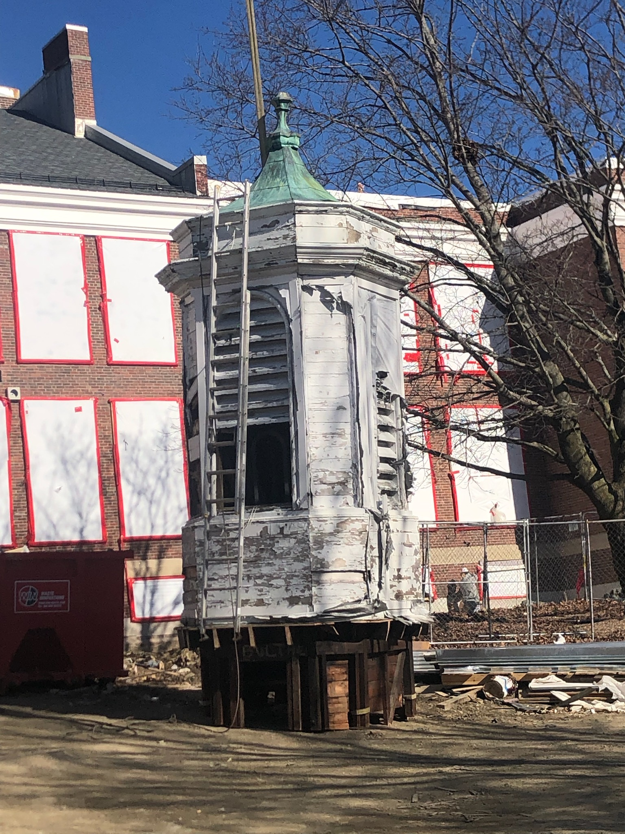
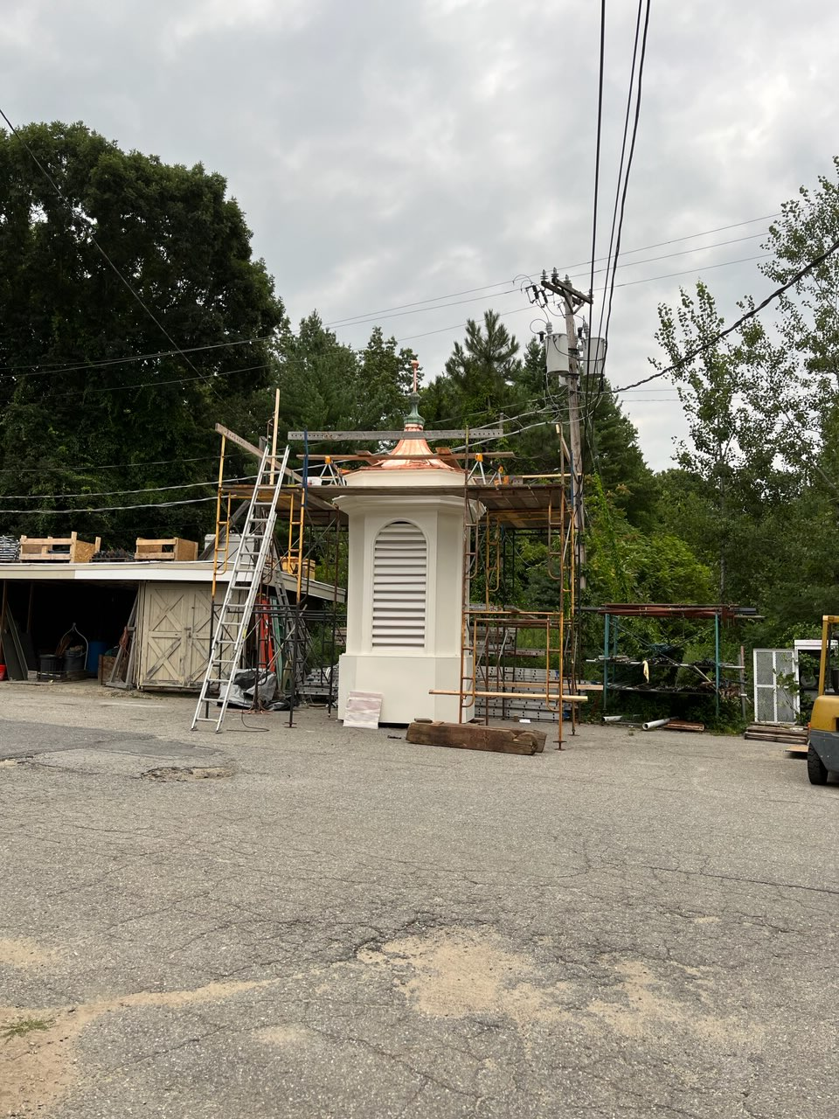
Watertown Public Schools Building Committee
Executive Summary

Slide 11
Watertown Public Schools Building Committee
Executive Summary
Lowell Elementary School
Electrical Switchgear delivered and Installed
Chiller ship date remains scheduled for August 23, 2023. Online by September 1, 2023
PV Panels completed this month
Casework and Millwork continues throughout August 2023
Flooring continues throughout August 2023
Ceilings and Painting continues throughout August 2023
Elevator Inspection – August 17, 2023
Lowell Elementary School cont.
Final Inspections – September 2023
Furniture, Fixture, and Equipment (FF&E)
September 5th – 22nd
Move Management / October 4th – 9th
Sitework and Landscaping
August –October 2023

Slide 12
Watertown Public Schools Building Committee
Questions / Comments
Those members of the public joining via Zoom, please use the Q&A button at this time to ask questions or email questions to:
buildingforfuture@watertown-ma.gov

Slide 13

www.hillintl.com

